Slide 1

Creating a Literacy-Rich Curriculum Unit
HCPS Grade 8 Social Studies Unit One:
Rise of America
Website

Slide 2
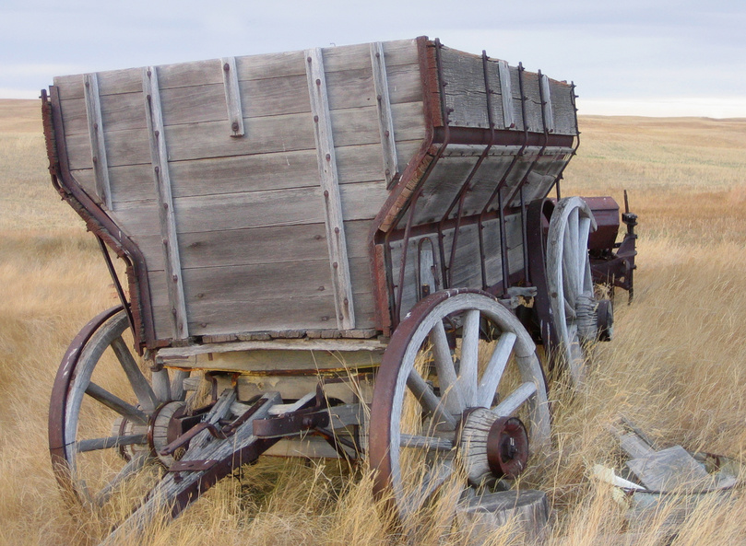
Background
Fallston Middle School
  Harford County
  mostly homogeneous in race and SES
  approximately 900 students total (approximately 300 in each grade level).
“Reading in the Secondary Content Areas” course FAIL ☹
Content information presented chronologically within a year
7th grade content = World Civilizations
“Rise of America” is the first unit

Slide 3
About the Unit:
Organized into three “experiences”
No breakdown of daily lessons
Each experience has “guiding questions” that relate to the “enduring understandings” for the entire year

Slide 4

Guiding Principles
Common Core State Standards description of college and career ready students
“Shared responsibility for students’ literacy developments” – CCSS

Slide 5
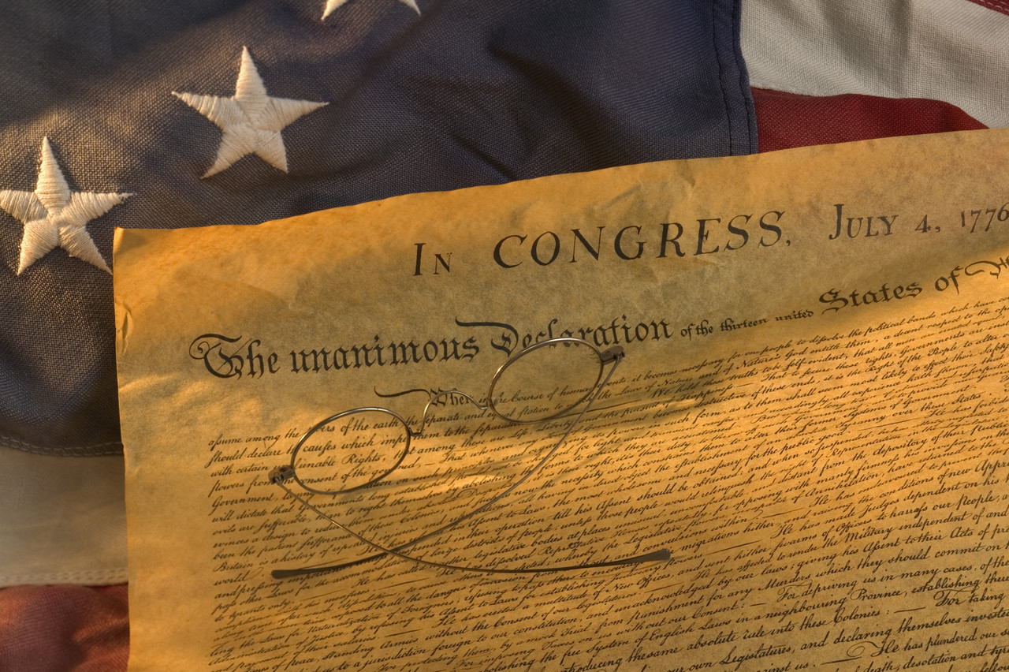
Included:
  State standards
  County indicators
  Guiding questions and enduring understandings
Missing:
  Daily objectives
Improvements:
  “A standard takes a year or more to achieve, while an objective can be achieved within a single lesson or class period”
  CCSS for reading and/or writing
  A daily user-friendly” objective
Objectives

Slide 6
Cultural Responsiveness
Included:
  Activities for students to share their existing knowledge and experiences and apply them to the lesson
  Many opportunities for students to read, write, and speak using a variety of instructional strategies
Missing:
  Overlooks the “History is written by the victors” perspective
Improvements:
  Inclusion of questions and activities that require students to challenge and reshape the content knowledge from the textbook and/or their own prior knowledge
  Celebrating the “Unsung Heroes” of history

Slide 7
Disciplinary Discourses
Included:
  Vocabulary integration (weak)
Missing:
  The main evaluative tools of historians: sourcing, contextualizing, and corroboration
Improvements:
  Introduction to sourcing, contextualizing, and corroboration
  Ongoing practice using exposure to multiple sources and research opportunities

Slide 8
English/Second Language Learners
Strong, intentional instructional planning
  Students access prior knowledge
  Previewing activities to prepare for new information
  Many opportunities for students to make connections to deepen understanding
  Many different instructional strategies with opportunities for interaction
  Different forms of application
  Reviewing to prepare for assessment

Slide 9

Use of Multiple Texts
Included:
  The Holt textbook, atlases, maps, student/teacher resource sheets
Missing:
  Everything else!
Improvements:
  Additional resources (nonfiction, biographies, etc.) and activities to gather & corroborate evidence
  Literature circle/Class Book Club opportunity
  Reader’s Workshop using multiple texts
  See website for recommended list of accessible, age-appropriate selections
  Teacher accountable for presenting/scaffolding difficult texts

Slide 10


Use of Multiple Literacies
Included:
  Did I mention the text, the atlas, and maps?
Missing:
  Everything else!
Improvements: Where to begin?!
  Websites and databases and Web. 20. , OH MY!
    See website
  Video clips from The History Channel
  Games (yes, GAMES!)

Slide 11

Strategic Reading and Learning
Included:
  Loosely followed BDA format
  Pre-reading strategies:
    Brainstorming
    Previewing
  During/After Reading = Notes/Handouts
Missing:
  Variety of during reading strategies and closure activities
Improvements:
  Clarity and variety of before reading strategies
  Inclusion of multiple forms of during reading strategies
    Post-It annotations
    Reader’s Workshop
    MANY vocabulary activities
    Conversation between characters writing
  Additions to after reading activities (more writing)

Slide 12
Classroom Organization and Practices
Included:
  Partnered/group activities (vague)
  Intervention/enrichment opportunities at end of each experience
Missing:
  Computer labs and libraries
  Too much teacher talk, not enough inquiry through interaction
Improvements:
  Clarity of classroom organization
  More student-centered activities
  Use of labs/libraries

Slide 13
Assessment
If it ain’t broke, don’t fix it!
Included:
  Formative assessments
    Writing activities
  Summative assessment (test)
    Includes different texts for students to use to answer questions
    Includes opportunities for students to write to demonstrate their understanding
Missing: Alternate forms of formative and summative assessments
Improvements: Extension Activities
  Formative assessments
  Summative “Read like a historian” research assignment to assess skills of sourcing, contextualizing, and corroboration

Slide 14
Before:
Procedures:
(1) As a motivational activity, ask students what is a tax and for what purposes they are used. Note student responses on the chalkboard or overhead, and explain that the following simulation is designed to demonstrate how the colonists felt about taxes imposed by the British government. Display Teacher Resource Sheet RA-6 and review the information with students. Conduct a class discussion about the policy, being sure to include the fairness of the policy and the lack of citizen input into the Board decision to implement this policy. Transition students back to a focus on how the colonists felt the British were using unlimited power against their legitimate right to rule themselves. Have students create an entry for Tax in their Vocabulary Notebook. [D1] [D2] [D3] [CC] [ETM 8] [ADPT 20: Provide students with a copy of Teacher Resource Sheet RA-6.]
(2) Remind students that the French and Indian War brought about many changes. As a result of the war, the British owned a lot more land and were in debt. Ask students to consider why these issues might have posed problems for the British government and the colonies. Lead students towards the understanding that the larger area to govern led to increased conflict between Native Americans and settlers moving into the new territory. The British, who already needed money to pay for the war; could not afford to send more resources to help protect the colonists and began raising taxes to pay for the maintenance of services in North America. In order for students to understand the causes of the American Revolution, distribute Student Resource Sheets RA-10a and RA-10b. This activity will introduce students to Episodic Note-Making [Note: Information on the Episodic Notes strategy is located in the Appendix of this curriculum guide]. As a pre-reading strategy, have students review the text features found on Pages 98-114 of the Holt United States History Student Text. Debrief for understanding using Teacher Resource Sheets RA-7a and RA-7b. [D3] [CC] [ETM 8] [ADPT 6: Have the student complete the task with a partner, within a small group, or as a total class activity.] [ADPT 11: Underline or highlight important information in reading material.] [ADPT 13: Divide the assignment into smaller tasks, setting appropriate time limits for completion.] [ADPT 18: Have students include Student Resource Sheets RA-10a and RA-10b in their Vocabulary Notebook.] [ADPT 23: Provide students with a model or framework of what an appropriate response should look like.]

Slide 15
After
EXPERIENCE 2
Day 1
Common Core State Standard(s)
Reading, Standard 4: Determine the meaning of words and phrases as they are used in a text, including vocabulary specific to domains related to history/social studies.
Reading, Standard 7: Integrate visual information with other information in print and digital texts
Writing Standard 4: Produce clear and coherent writing in which the development, organization, and style are appropriate to the task, purpose, and audience
Writing Standard 10: Write routinely over an extended time frames and shorter time frames for a range of discipline-specific tasks, purposes, and audiences
General Objective(s)
Students will analyze the outcome of the French and Indian War to determine how it led to conflict between Native Americans and settlers, and conflict between the British and colonists
Students will complete a reader’s workshop to take episodic notes which identify the causes of the Revolutionary War
Core text (print, textbook, visual media, online):
Holt United States History student text
Supplemental text(s) (print, textbook, visual media, online):
Teacher resource sheet or local newspapers
Prezi presentation: Causes of the American Revolution
History Channel Video Clips
BDA/SIOP Activities & Classroom Organization (from the original unit, with my additions in italics):
As a motivational activity, ask students what is a tax and for what purposes they are used. Note student responses on the chalkboard or overhead, and explain that the following simulation is designed to demonstrate how the colonists felt about taxes imposed by the British government. Display Teacher Resource Sheet RA-6 (a simulation in which the Board of Education institutes several taxes on students to make up for revenue cut by the county, and a list of offenses for not paying) and review the information with students. (As an alternate option, provide students with recent copies of the local newspaper which detail the real-life impact that county budget cuts have had on the local Board of Education, such as reductions in staff which cut positions and/or force higher class sizes, thus directly impacting students) Conduct a class discussion about the policy, being sure to include the fairness of the policy and the lack of citizen input into the Board decision to implement this policy. Transition students back to a focus on how the colonists felt the British were using unlimited power against their legitimate right to rule themselves. Have students create an entry for Tax in their Vocabulary Notebook.
Remind students that the French and Indian War brought about many changes. Display the following events, listed on separate cards, for students to put in order using knowledge of cause and effect as a whole-class or in small groups:
  As a result of the French and Indian war, the British owned a lot more land and were in debt
  The British, who already needed money to pay for the war; could not afford to send more resources to help protect the colonists
  The British began raising taxes to pay for the maintenance of services in North America.
  Conflict increases between Native Americans and settlers moving into the new territory.
To prepare students to read the textbook, preview the material by showing the Prezi on Causes of the American Revolution.
In order for students to understand the causes of the American Revolution, distribute Student Resource Sheets RA-10a and RA-10b. This activity will introduce students to Episodic Note-Making. As a pre-reading strategy, have students review the text features found on Pages 98-114 of the Holt United States History Student Text.
Have students complete the reading in a Reader’s Workshop style, working in small traveling groups to read/view the following information to complete their notes. Students should annotate the text on Post-Its as they read to make comments/ask questions.
  The student text, pages 98-114, chunked into instructional sections
  The History Channel video clips (scroll to bottom of site to access each):The Colonies Protest British Policies, The Sons of Liberty and the Boston Tea Party, The Boston Massacre, First Revolutionary Battle at Lexington and Concord
As students read, address questions they have.
Debrief for understanding using Teacher Resource Sheets RA-7a and RA-7b.
As an exit ticket, have students synthesize and summarize the information by writing a brief constructed response explaining what caused the American Revolution.

